Slide 1


Nerea Caldés
13/08/2023

Slide 2
Outline
- Executive Summary
- Introduction
- Methodology
- Results
- Conclusion
- Appendix

Slide 3
Executive Summary
Methodologies:
Data Collection
Data Wrangle
EDA with SQL
EDA with Data Visualization
Interactive visual analytics and Dashboards
Results:
EDA
Visualization
Predictive analytics

Slide 4
Introduction
- Project background and context:
SpaceX offers Falcon 9 rocket launches at $62 million, a significant cost reduction compared to other providers due to their ability to reuse the first stage. Predicting the first stage's landing outcome allows for accurate cost estimation of a launch. This data is valuable for competing companies considering bidding against SpaceX for a rocket launch. The module provides an introduction to the issue and equips participants with essential tools for course completion.
- Problems you want to find answers:
- Trend in successful landings over a period
- Elements that will influence the successful landing
- Specific circumstances are necessary to guarantee the success landing

Slide 5
Methodology
Executive Summary
- Data collection: Data is collected using SpaceX REST API and also web scraping techniques (Wikipedia)
- Data Wrangle: Identify missing values, filter data, using One Hot encoding.
- Perform exploratory data analysis (EDA) using visualization and SQL:
- SQL: Using SQL queries to extract necessary data from data base
- Visualization: relationship between different parameters, using dummy variables and encoding to represent data in Scatter Graphs, Bar Graphs, Line Graphs…
- Perform interactive visual analytics using Folium and Plotly Dash
- Perform predictive analysis using classification models: How to build, tune, evaluate classification models

Slide 6
Data Collection – SpaceX API
Steps to get data from SpaceX API:
Use get function from library “requests“ to make HTTP request to API URL.
Decode response and normalize data using functions from “json” library
Get specific columns from API (with obtained IDs) and store it in lists
Create a dictionary from lists data combining columns
Create Pandas data frame

Slide 7
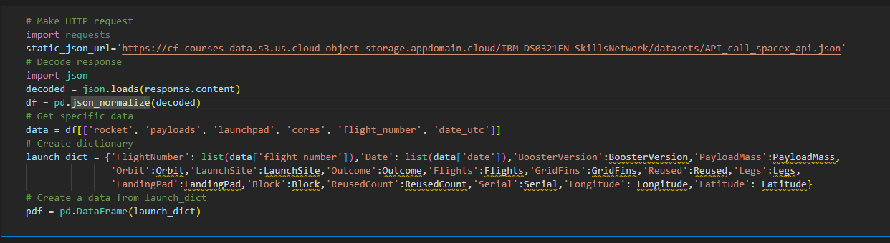
Data Collection – SpaceX API
Link to Github

Slide 8
Data Collection - Scraping
Steps to get data from SpaceX API:
Request the HTML page from Wikipedia URL and get response
Create a BeautifulSoup object from the HTML response
Find tables and check content from a targeted table
Iterate through <th> elements to extract the column names
Create a dictionary with keys from the extracted column names
Fill dictionary with data in the table
Create Pandas data frame from dictionary

Slide 9
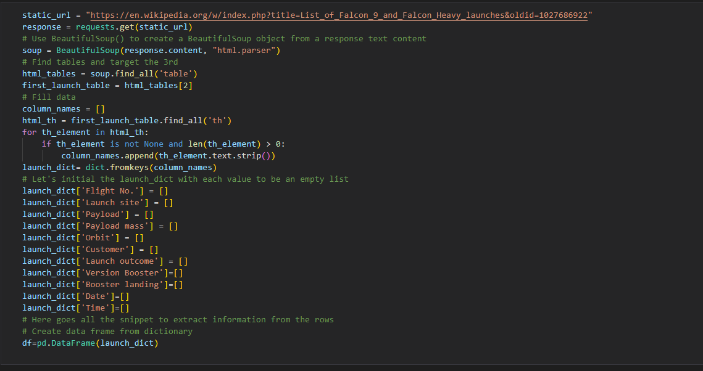
Data Collection – Scraping
Link to Github

Slide 10
Data Wrangling
Steps to data wrangling:
Perform EDA and determine training labels
Calculate number of launches on each site
Calculate number and occurrence of each orbit
Calculate number and occurrence of mission outcome per orbit type
Create a landing outcome label from outcome column considering 0 as bad outcome and 1 otherwise

Slide 11
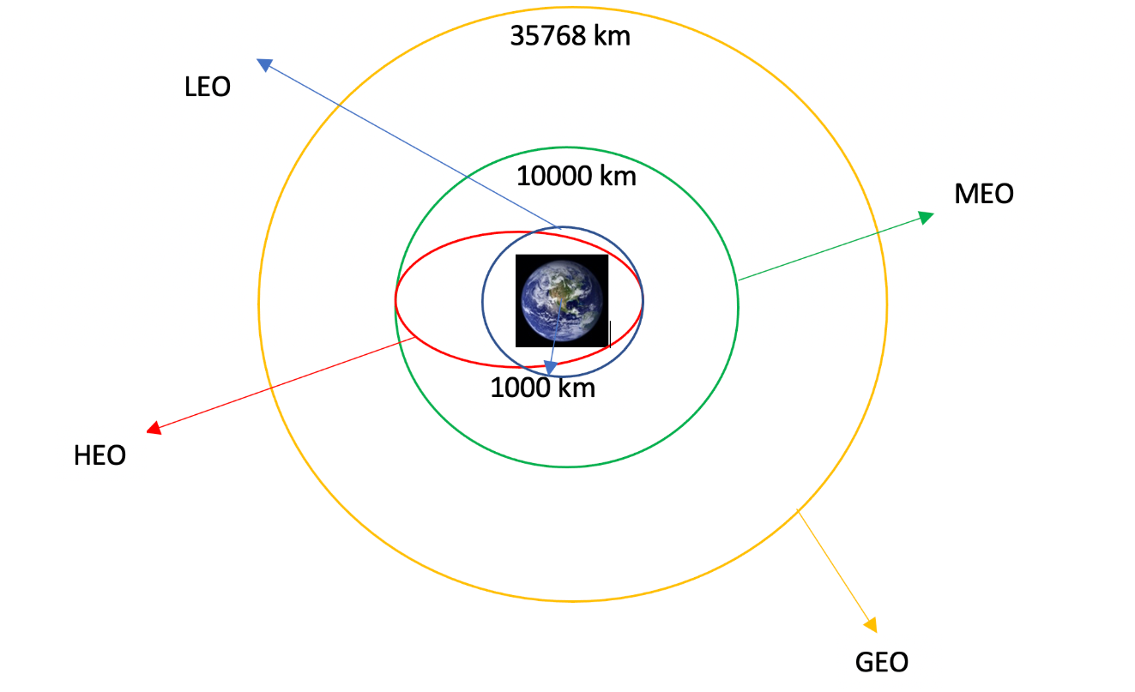
Data Wrangling
Link a Github

Slide 12
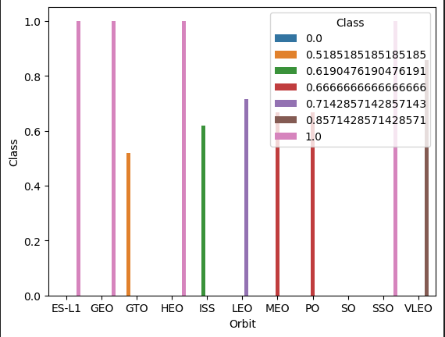
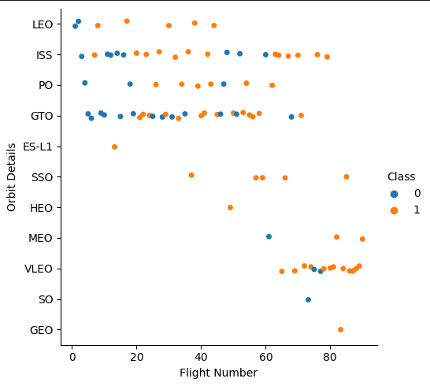
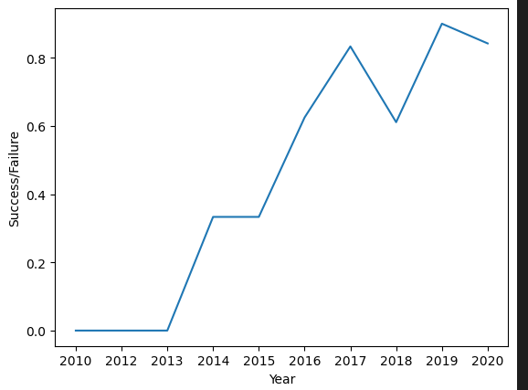
EDA with Data Visualization
Scatter Graph for correlation analysis:
Flight number vs Payload Mass
Flight number vs Launch Site
Payload vs Launch Site
Orbit vs Flight number
Payload vs Outcome
Orbit vs Payload Mass
Bar Graphs:
Orbit types
Line Graphs:
Success Rate vs year
Link to Github

Slide 13
EDA with SQL
Connect to data base from Jupyter Notebook and few queries. Some of them are:
Display names of the unique launch site in the space mission
Display 5 records where launch sites begin with the string 'KSC’
Display average payload mass carried by booster version F9 v1.1
List the total number of successful and failure mission outcomes
Link to GitHub

Slide 14

Build an Interactive Map with Folium
Mapped all launch sites, added markers, circles, and lines indicating launch success/failure on the folium map.
Assign launch outcomes (0 is failure and 1 is success)
Calculate distance from the launch site to different landmarks and draw lines in the map to measure distance
Link to GitHub

Slide 15
Build a Dashboard with Plotly Dash
Added a launch site drop-down input component
A callback function to render a pie chart for success records based on drop-down
A range slider to select Payload
A callback function to render the scatter chart for success records
Link to GitHub

Slide 16
Predictive Analysis (Classification)
Load data and create an array using numpy.
Standardize data and split it into training and testing data
Create the following machine learning objects (Logistic regression, Vector machine , Decision Tree Classifier, k nearest neighbors) also with GridSearchCV and fit it to find the best parameters from given dictionaries.
Calculate the accuracy on the test data using the method score() to find predictive data
Link to GitHub

Slide 17
Results
- Exploratory data analysis results
- Interactive analytics demo in screenshots
- Predictive analysis results

Slide 18

Section 2

Slide 19
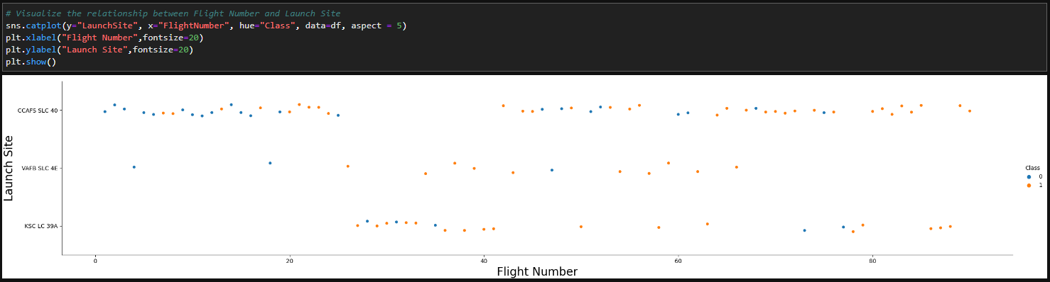
Flight Number vs. Launch Site
It is shown that the more amount of flight number is at launch site, the greater the success rate at launch site
Link to GitHub

Slide 20
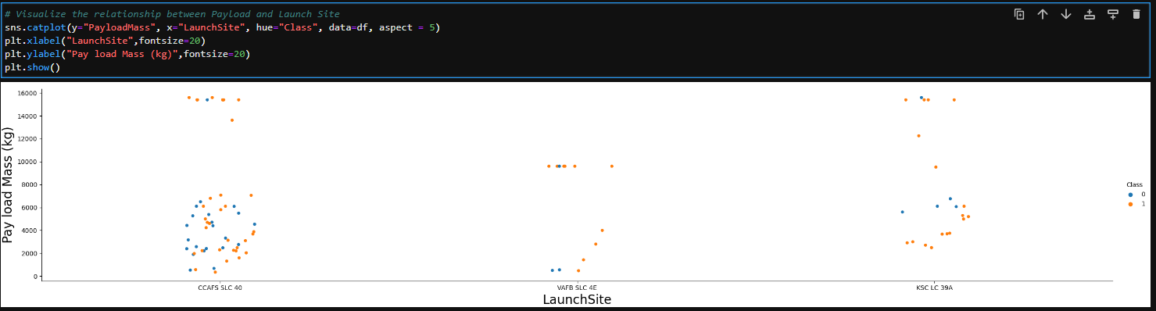
Payload vs. Launch Site
Here, as higher the Payload Mass is, the higher the success rate.
Link to GitHub

Slide 21
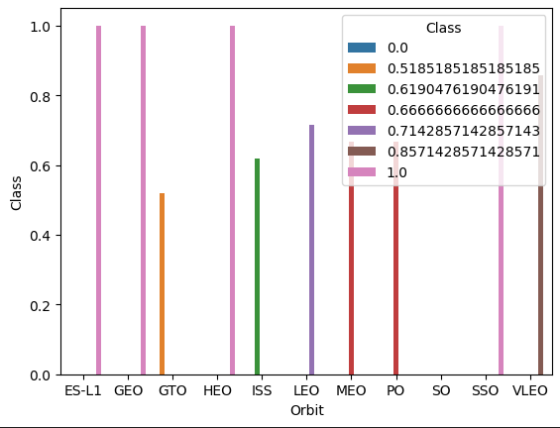
Success Rate vs. Orbit Type
Orbits ES-L1, GEO, HEO and SSO have 100% Success Rate. Lowest is SO
Link to GitHub

Slide 22
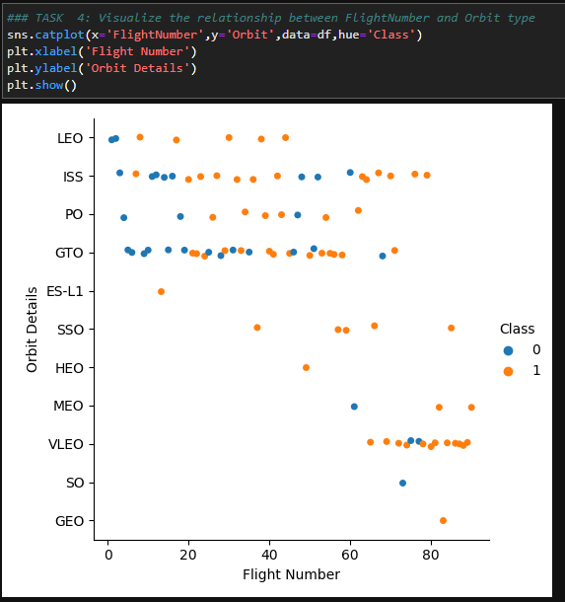
Flight Number vs. Orbit Type
LEO orbit: Success tied to flight count. GTO orbit: No correlation.
Link to GitHub

Slide 23
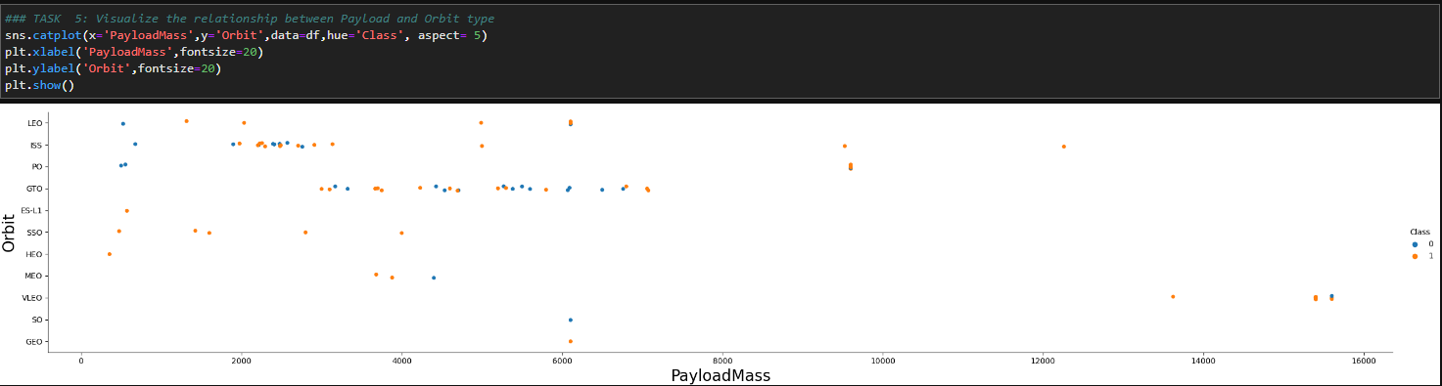
Payload vs. Orbit Type
Heavier payloads correlate with higher successful landings in PO, LEO, and ISS orbits.
Link to GitHub

Slide 24
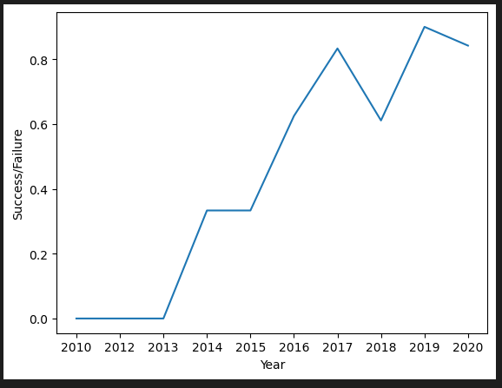
Launch Success Yearly Trend
The plot shows a consistent increase in success rate from 2013 to 2020.
Link to GitHub

Slide 25
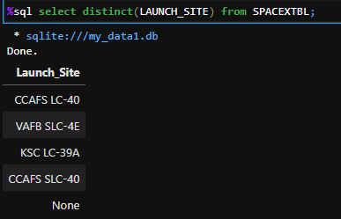
All Launch Site Names
"Distinct" keyword used to display unique launch sites in SpaceX data.
Link to GitHub

Slide 26
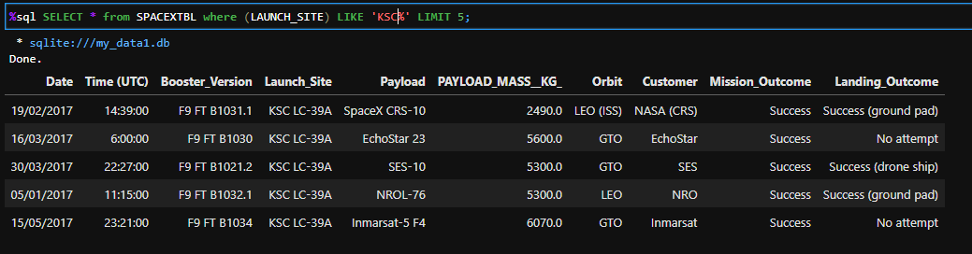
Launch Site Names Begin with 'KSC'
Used query to show 5 'KSC' launch site records.
Link to GitHub

Slide 27
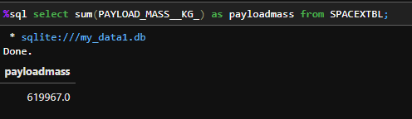
Total Payload Mass
Query yielded NASA's booster payload sum: 45596.
Link to GitHub

Slide 28
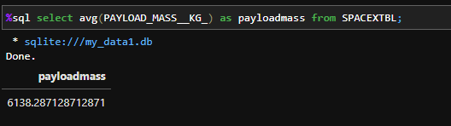
Average Payload Mass by F9 v1.1
Average payload mass of F9 v1.1 booster: 2928.4.
Link to GitHub

Slide 29
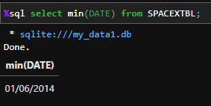
First Successful Ground Landing Date
First successful ground pad landing: June 1, 2014.
Link to GitHub

Slide 30
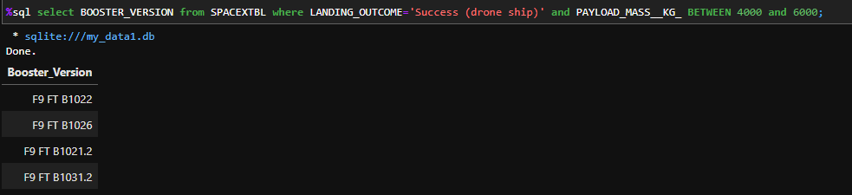
Successful Drone Ship Landing with Payload between 4000 and 6000
Filtered for successful drone ship landings and payload mass between 4000 and 6000 using WHERE and AND clauses.
Link to GitHub

Slide 31
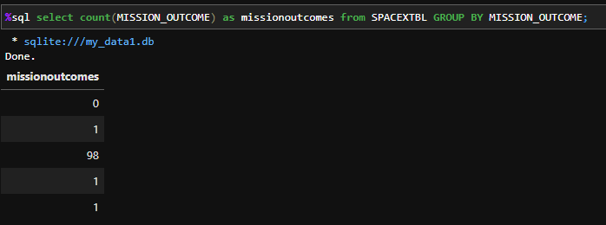
Total Number of Successful and Failure Mission Outcomes
Utilized wildcard '%' to filter WHERE MissionOutcome as success or failure.
Link to GitHub

Slide 32
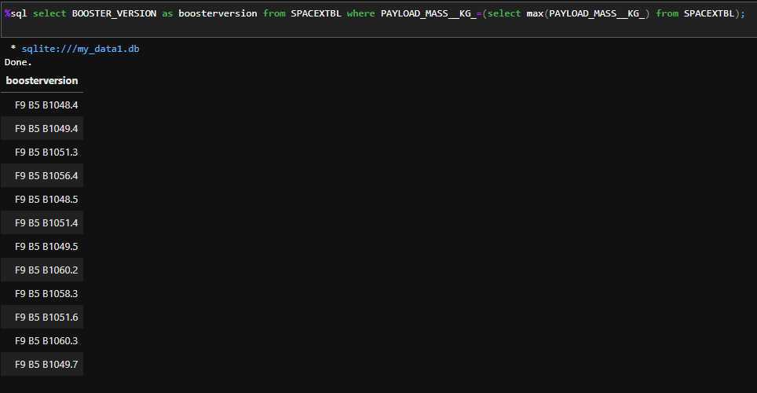
Boosters Carried Maximum Payload
Identified max payload-carrying booster using subquery in WHERE with MAX() function.
Link to GitHub

Slide 33
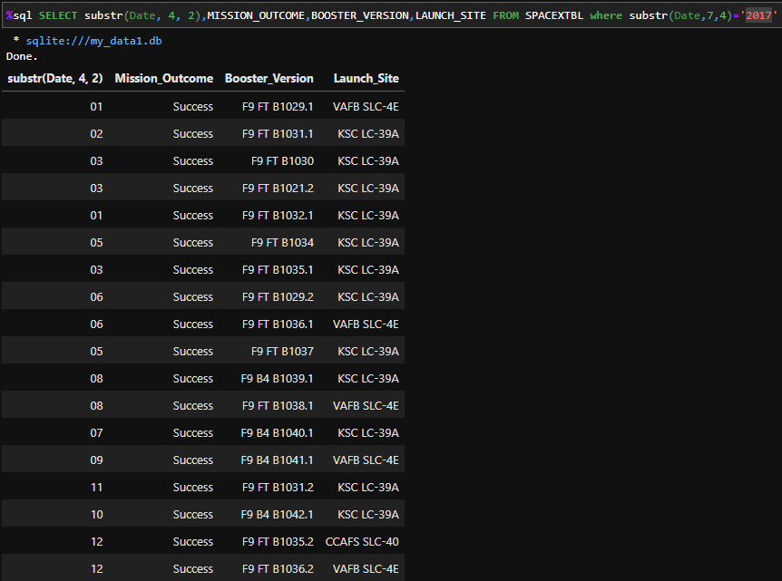
2017 Launch Records
List the records which will display the month names, succesful landing_outcomes in ground pad ,booster versions, launch_site for the months in year 2017
Link to GitHub

Slide 34
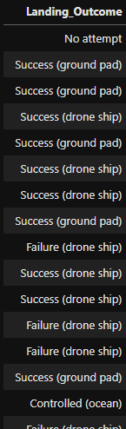
Rank Landing Outcomes Between 2010-06-04 and 2017-03-20
Rank the count of landing outcomes (such as Failure (drone ship) or Success (ground pad)) between the date 2010-06-04 and 2017-03-20, in descending order
Link to GitHub

Slide 35

Section 3

Slide 36
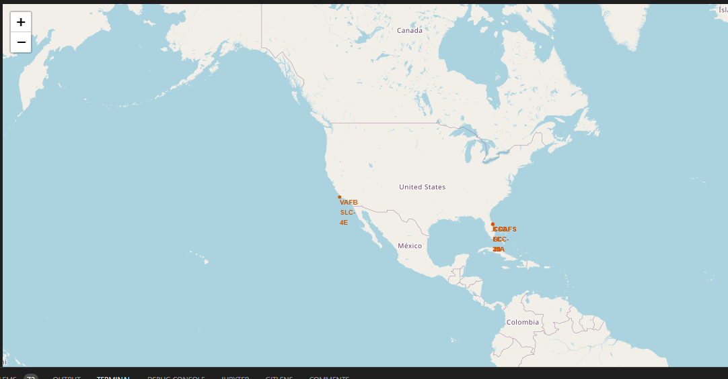
All launch sites map markers
Proximity to equator aids equatorial launches, leveraging Earth's rotation for prograde orbits. Near-equator sites gain natural boost, saving fuel and costs.
Link to GitHub

Slide 37
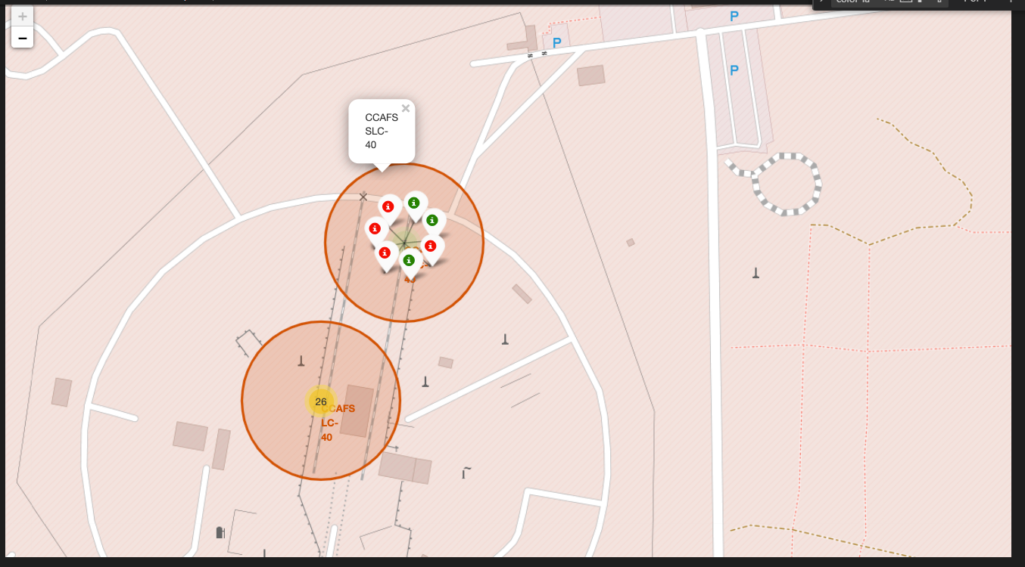
Launch outcomes color-labeled
Link to GitHub

Slide 38
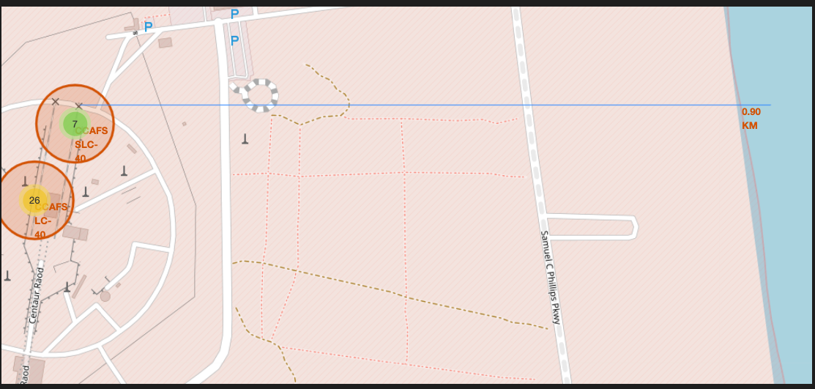
Launch site coordinate with distance by Polyline
Link to GitHub

Slide 39

Section 4

Slide 40
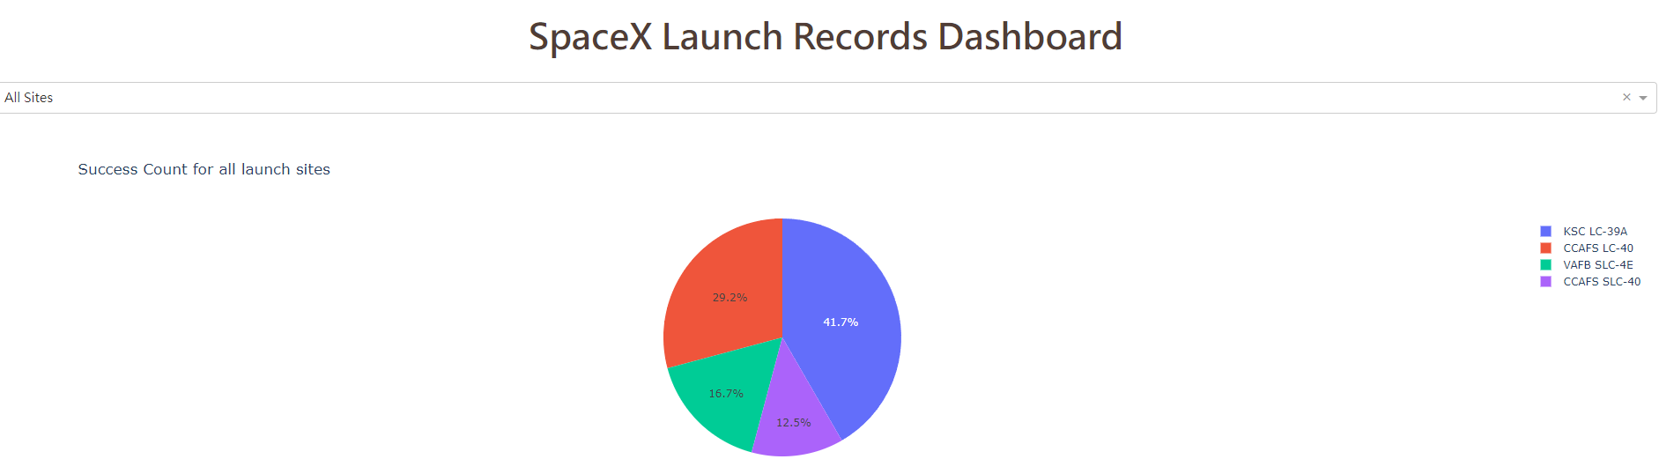
Success launches Pie Chart
KSC LC-39A has the most successful launches from all sites.
Link to GitHub

Slide 41
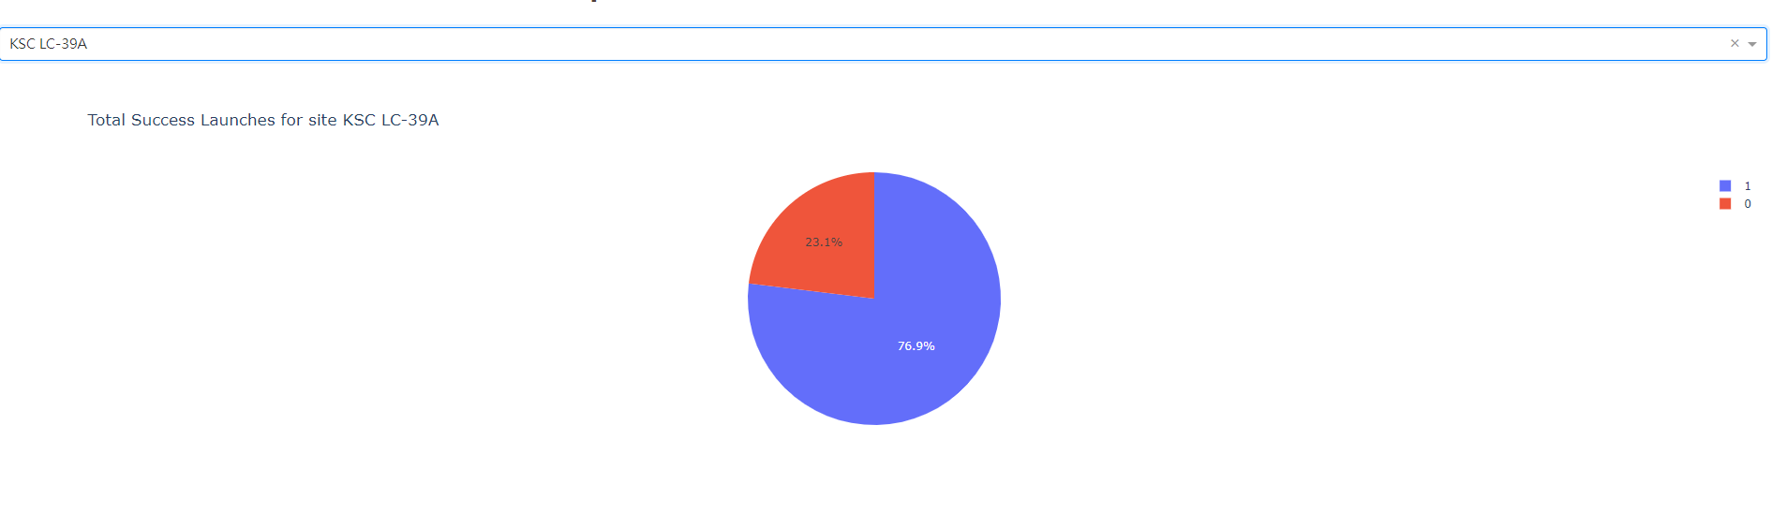
High launch success ratio pie chart
KSC LC-39A has the highest success rate amongst launch sites
Link to GitHub

Slide 42
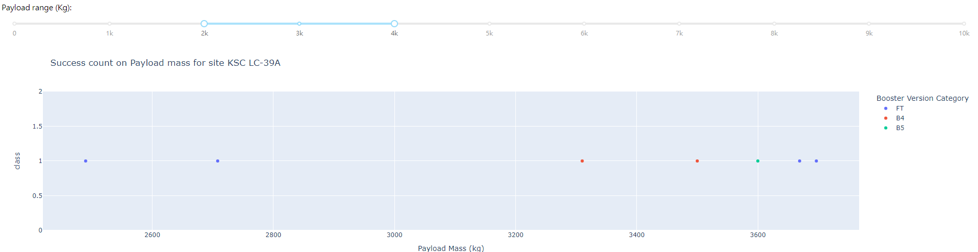
Payload Mass and Success
Link to GitHub

Slide 43

Section 5

Slide 44
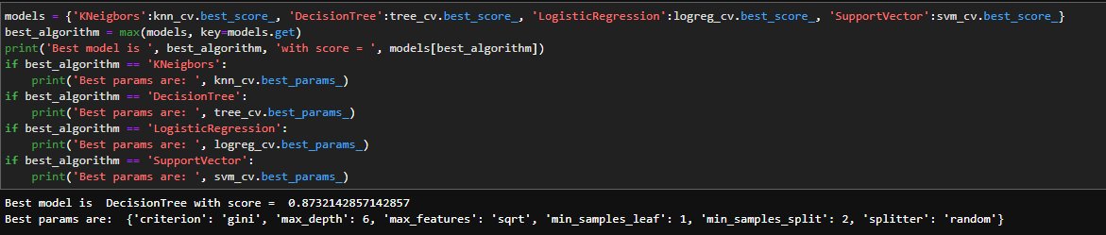
Classification Accuracy
The decision tree classifier is the model with the highest classification accuracy
Link to GitHub

Slide 45
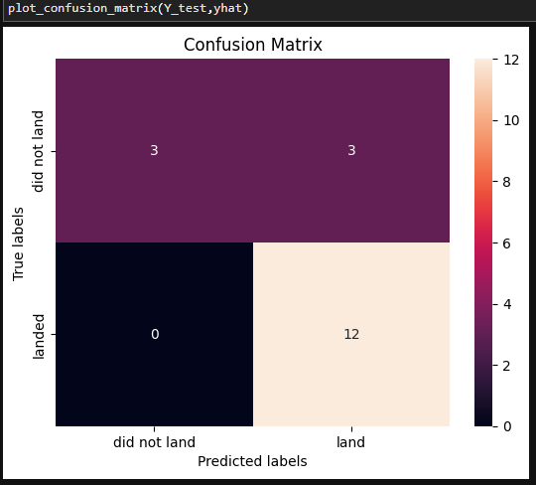
Confusion Matrix
Decision tree matrix differentiates classes but struggles with false positive: unsuccessful landings misclassified as successful.
Link to GitHub

Slide 46
Conclusions
Positive correlation between launch site flight volume and success rate.
Orbits: ES-L1, GEO, HEO, SSO, VLEO excelled in success.
KSC LC-39A dominated successful launches.
Decision tree classifier emerged as optimal ML algorithm for task.
Link to GitHub

Slide 47


